Slide 1
Fraud Prevention in Financial Transactions with Random Forest Decision Trees
Jeffrey E. Crosby
DS504 – Big Data Analytics
10/24/2019

Slide 2
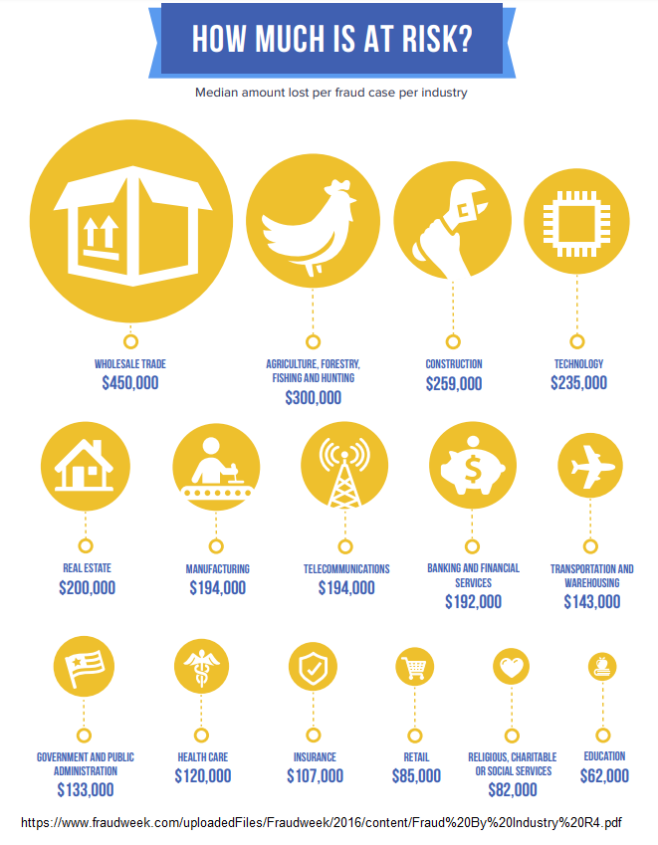
Fraud is an unknown and hidden cost of doing business in many organizations. What we don’t often recognize is that losses due to fraud directly impact the bottom line of an organization, and that it takes many times over the same amount in revenue, just to “catch up”, if it were possible. Even more concerning is the fact that most organizations fail to report fraud for fear of loss of reputation, or trust. The best solution of course, is prevention.
Notes:
This PowerPoint Template includes a series of slide masters with predefined layouts and color schemes for formatting slides
Slide Masters are displayed when you right click on a slide and select Layout from menu

Slide 3
Detect and Proactively Intercept Fraudulent Financial Transactions
Proposal
We seek to identify characteristics of fraudulent transactions by using decision trees. Decision trees allow computers to study large volumes of data, and “learn” the characteristics of fraud. With a properly developed and tested program, it is within our grasp to monitor transactions, and to alert and hold those suspected of fraud, for either further review, or cancellation.

Slide 4
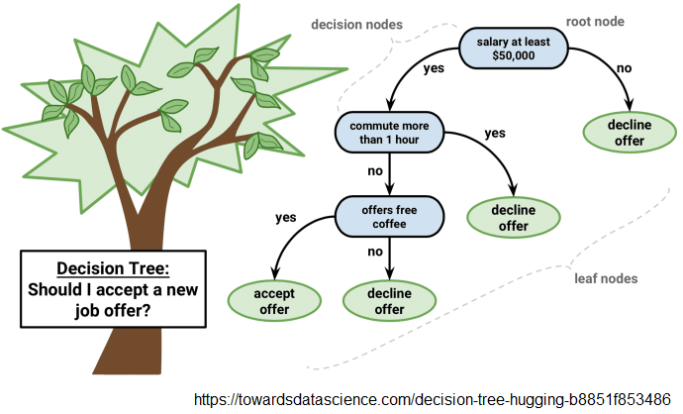
Decision Trees
Decision trees conceptually work upside of those in nature, with the root at the top as a starting point, and various decision-making nodes resulting in more and more branches as you progress down.

Slide 5
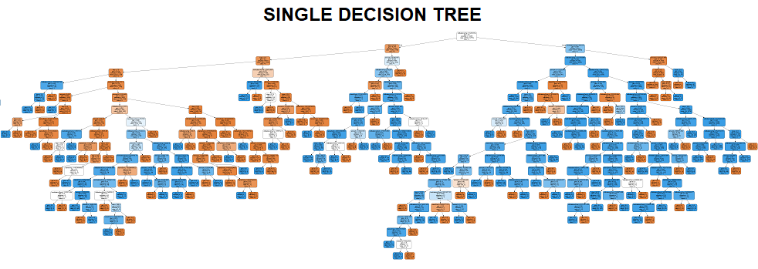
Example: Single Tree
In the world of data science, decision trees aren’t typically made for viewing, so much as they constructed to optimize functionality. As you can see in the example above, decision trees can become very large, and somewhat more difficult to interpret as a human. Generally, effective solutions combine many decisions trees in an “ensemble” decision tree method, such Random Forest.

Slide 6
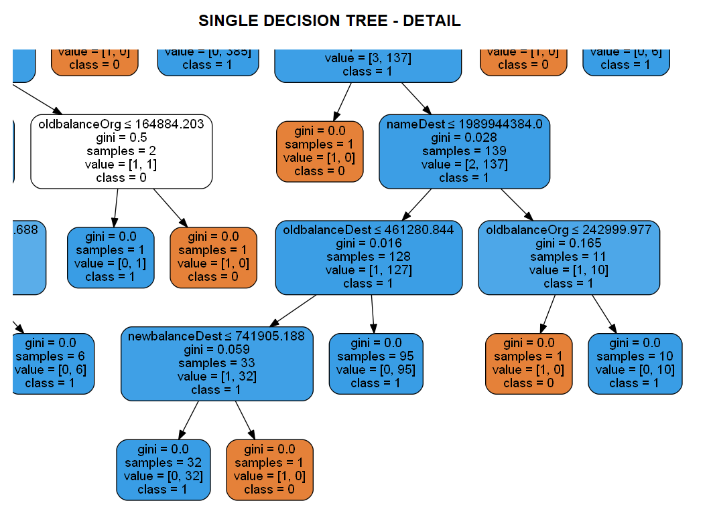
Single Tree Detail
Here is an enlarged portion of the previous decision tree, where you can see the decision nodes and results. For a classification problem like fraud (yes or no), the result is a “class” of 0 for no, and 1 for yes. The tree takes data provided and computes decisions based on the “purity” of the results at different amounts or conditions.

Slide 7
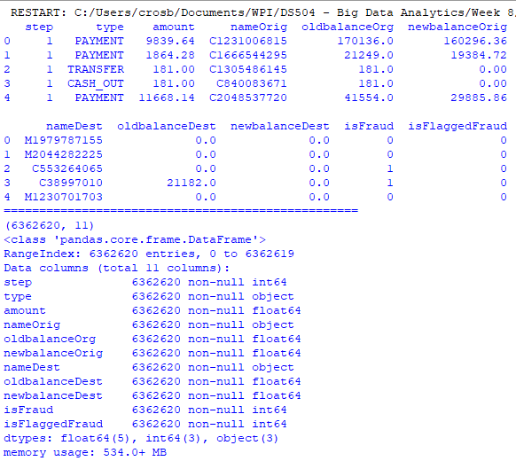
Data
For development of this project, data was sourced from Kaggle in order to provide a realistic proposal, without risking protected private data. 6.3 million records were created from real consumer data in an unnamed African country, with fictitious fraudulent records created and inserted by a simulator called “PaySim”. There are eleven columns, or features detailing the records of these financial transactions over the period of a month.

Slide 8
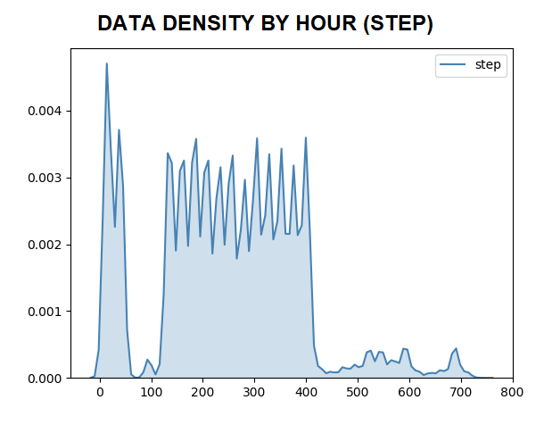
Data Analysis & Preparation
To be successful, a data science project such as this requires a great deal of study of the data itself before any other work is done. This ensures proper analysis as well as to prevent confirmation bias in the proposed solution itself. Here we see over the course of the month’s data supplied, a distribution of records by hour, referred to as “step” in the data.

Slide 9
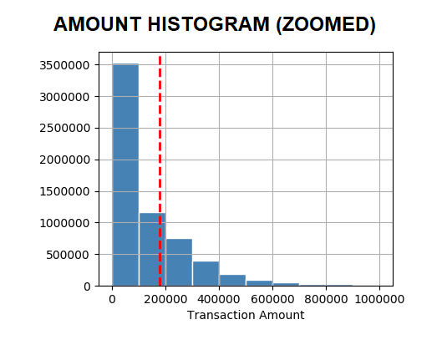
Data Analysis & Preparation
Here, instances of amount are bucketed in a histogram to illustrate the distribution of transactions by monetary value. Certainly, most transactions are of the lowest range of values, as you’d expect.
This is but one of the many possible features we can use in conjunction to identify fraudulent transactions.

Slide 10
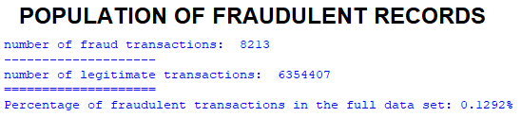
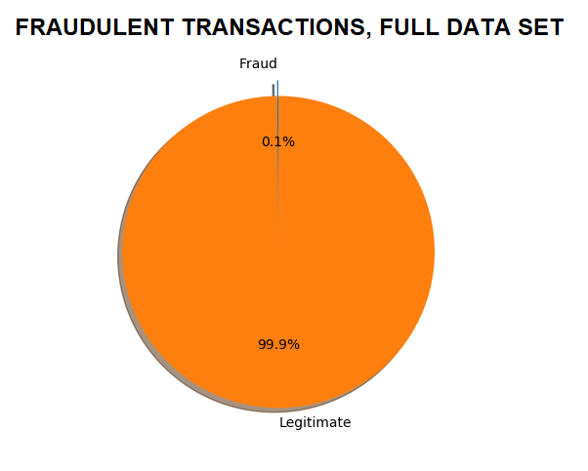
Data Analysis & Preparation
Upon further study, it becomes obvious that this data is heavily biased towards legitimate transactions. The proportion of fraudulent transactions is very small, just over a tenth of one percent. This could and will make discerning actual fraud difficult, and could possibly inflate or misrepresent performance results of our model. Therefore, we will balance the data by reducing the data set to an equal number of fraudulent and legitimate transactions.

Slide 11
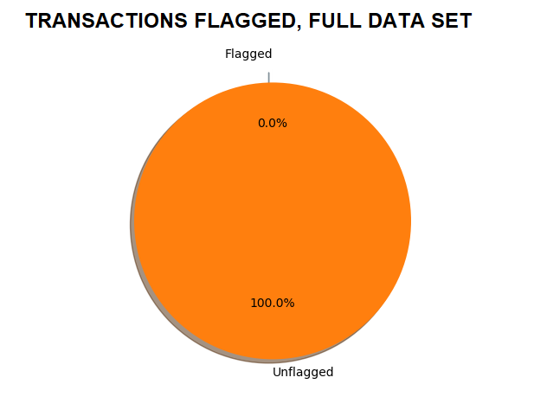
Data Analysis & Preparation
Even fewer transactions are marked in the “isFlaggedFraud” column. Only sixteen records are identified as fraud in this column. The actual instances of fraud are recorded in the “isFraud” column, totaling 8,213 records. Balancing the data is achieved by random sampling to reduce the legitimate transactions to an equal 8,213, and a data set of 16,426 records. On the next slide, we will see the distribution of fraud on this selected data set, amongst nine features, visually attempting to indicate strong indicators.

Slide 12
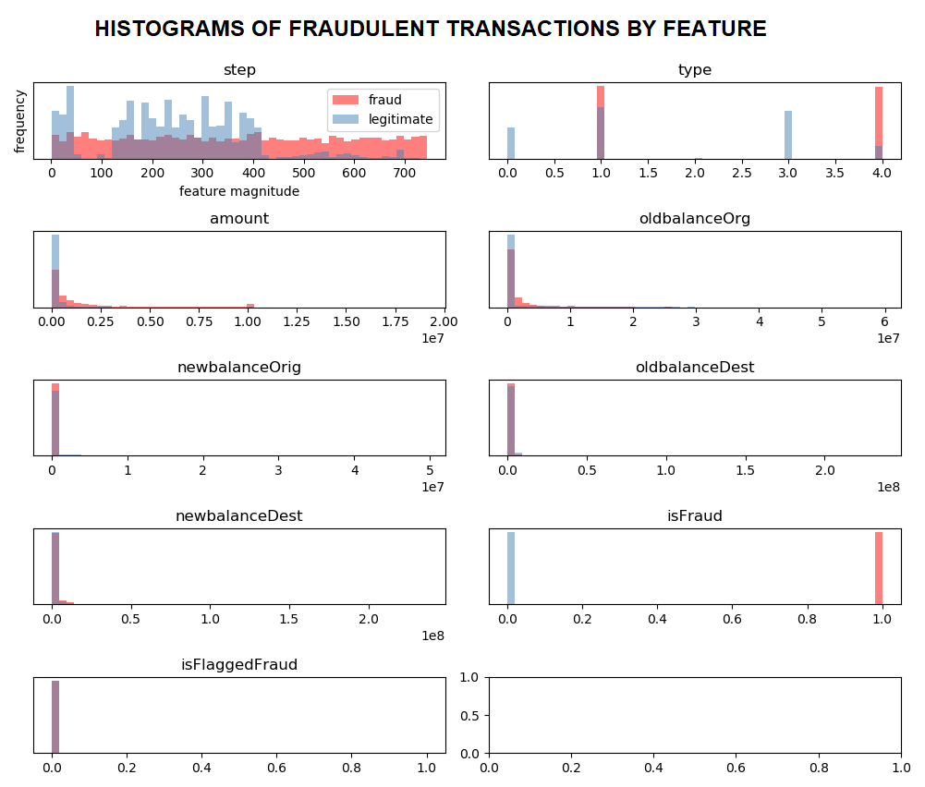
distribution of fraudulent transactions among the nine selected features

Slide 13
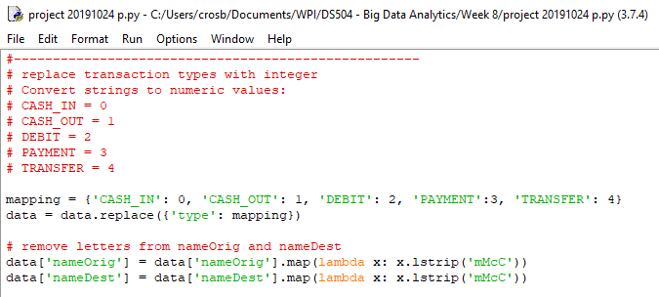
Tokenization
In order to process data for machine learning, such as in the use of decision trees, text values such as the transaction types “CASH_IN”, “CASH_OUT”, “DEBIT”, “PAYMENT”, and “TRANSFER” must be converted to numeric values.

Slide 14
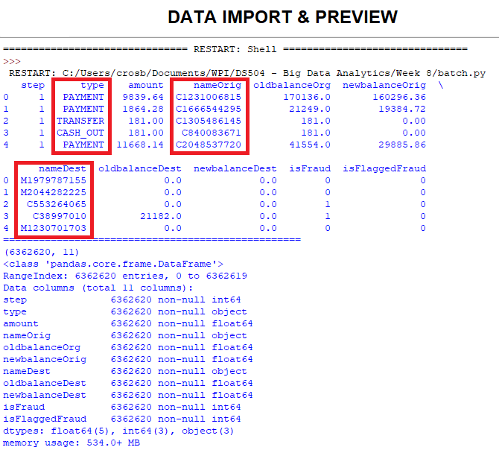
Tokenization
Similarly, the account numbers in “nameOrig” and “nameDest” must have the letters removed to prepare the data for machine learning algorithms.

Slide 15
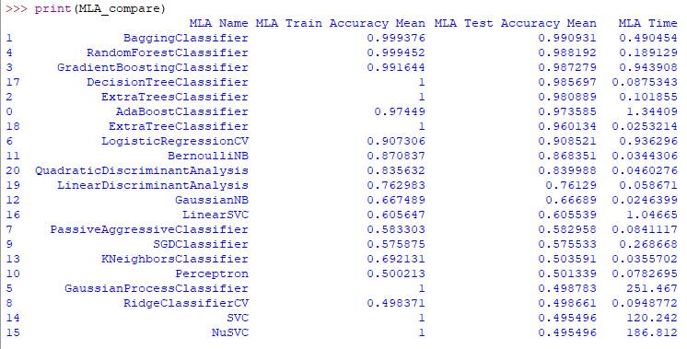
Machine Learning Algorithms
Once the data is prepared, several different models and algorithms are tested to determine the best method or methods for a proposed solution. Here, and in the next slide, we see that the BaggingClassifier and RandomForestClassifier demonstrate accuracy very near 100%.
Notes:
BEST PRACTICES:
Open Excel 2007 before creating charts in PowerPoint
Duplicate this slide and edit data

Slide 16
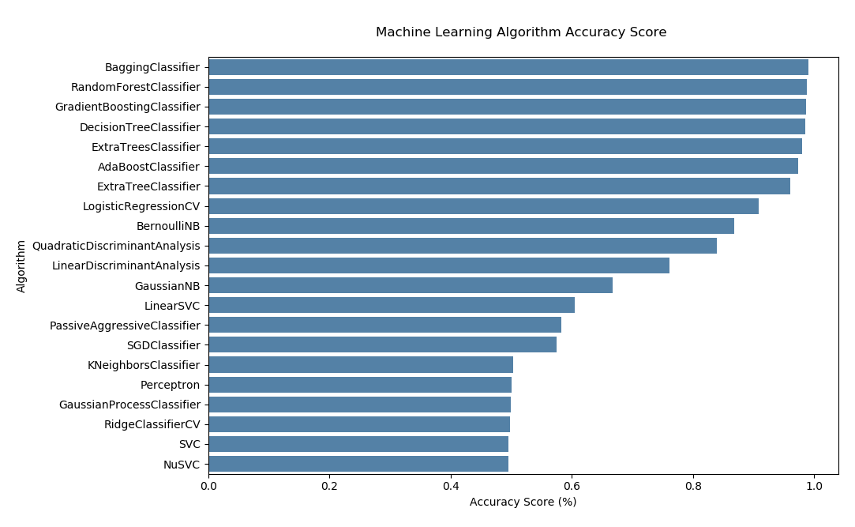
Machine Learning Algorithms
While these methods can be very powerful, these results seem extraordinary and the model may not generalize well to new unseen data.
Notes:
BEST PRACTICES:
Open Excel 2007 before creating charts in PowerPoint
Duplicate this slide and edit data

Slide 17
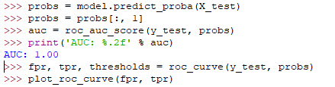
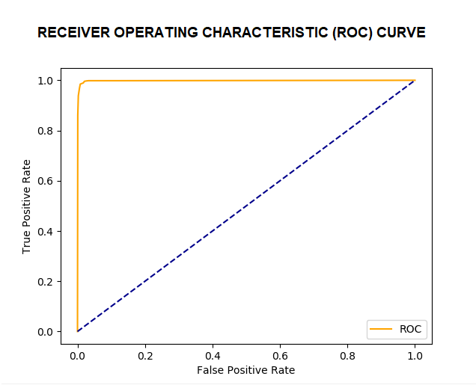
Model Validation
Another way to measure accuracy is with the Receiver Operating Characteristic (ROC) Curve, which plots false positive and true positive rates again a plot of unskilled guessing. Unskilled guessing generally results in a 50% chance of “getting it right”, as indicated by the line drawn in blue, right up the middle. Here we see another very high rating at 100%.
Notes:
BEST PRACTICES:
Open Excel 2007 before creating charts in PowerPoint
Duplicate this slide and edit data

Slide 18
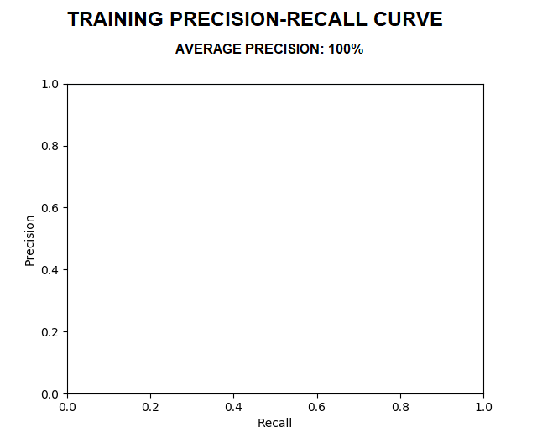
Model Validation
In the case of predicting fraud, and similar circumstances, perhaps a better indicator is the Precision Recall Curve. This is true in cases where classes are highly imbalanced. Here precision is a measure of how relevant your results are, while recall measures how many relevant results are actually returned. Once again, results are very high, at 100% average precision.
Notes:
BEST PRACTICES:
Open Excel 2007 before creating charts in PowerPoint
Duplicate this slide and edit data

Slide 19
Conclusion
The proposed Random Forest solution appears to be inefficient with the imbalanced transaction data necessary to detect fraud.
Methods of measuring the model appear to be misrepresenting the true results
Additional research and development is necessary
We recommend an additional period of time to develop and test an Isolation Forest model

Slide 20
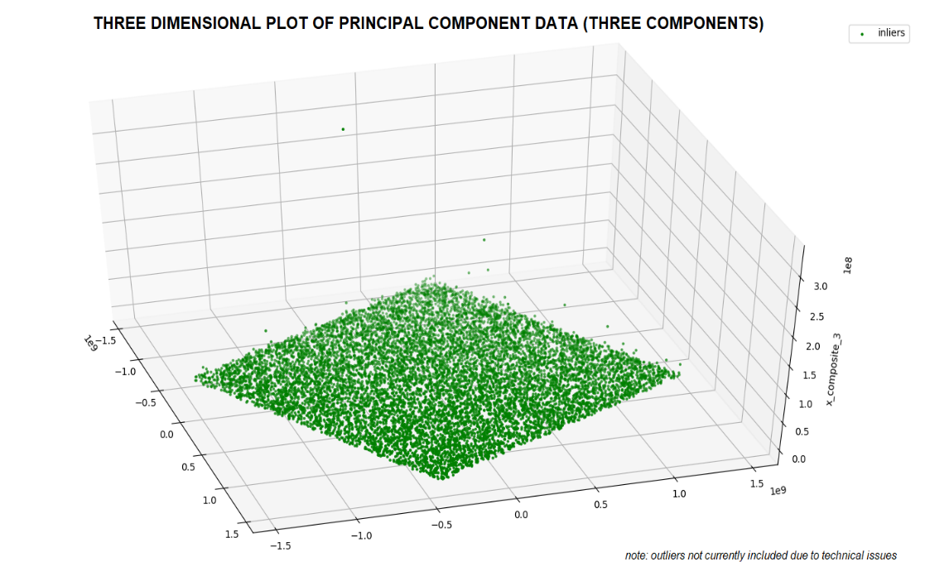
Conclusions
During the course of this analysis, we have determined that the unbalanced nature of fraudulent transactions are better handled by a different type of ensemble tree method, Isolation Forest. This method seeks and measures outliers first, instead of excluding or discounting them. This is more appropriate for detecting financial fraud.
Notes:
BEST PRACTICES:
Open Excel 2007 before creating charts in PowerPoint
Duplicate this slide and edit data

Slide 21
Thank you for attending
Notes:
This PowerPoint Template includes a series of slide masters with predefined layouts and color schemes for formatting slides
Slide Masters are displayed when you right click on a slide and select Layout from menu

